Slide 1



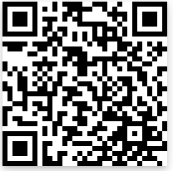
Welcome to the world of Augmented Reality (AR)
Pre-Survey: https://ggc.az1.qualtrics.com/jfe/form/SV_agHt1hYCg624R3U

Slide 2

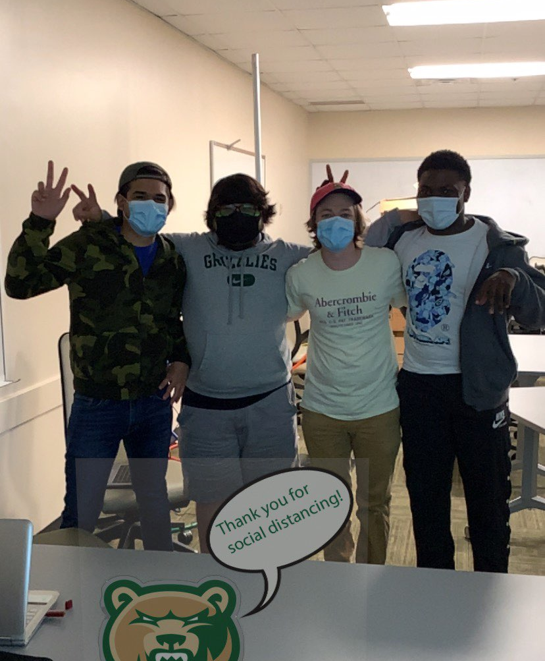
What is TAP
TAP is a service-based learning course in which students create an outreach project to encourage others to pursue a technology and IT related career.
Notes:
TAP is a service-based learning course in which students create an outreach project to encourage others to pursue a technology and IT related career.

Slide 3
What We Hope and Our Vision
Our vision is to get everyone excited about our AR technology and understanding the benefits in many fields including marketing, education, and medical fields.

Slide 4
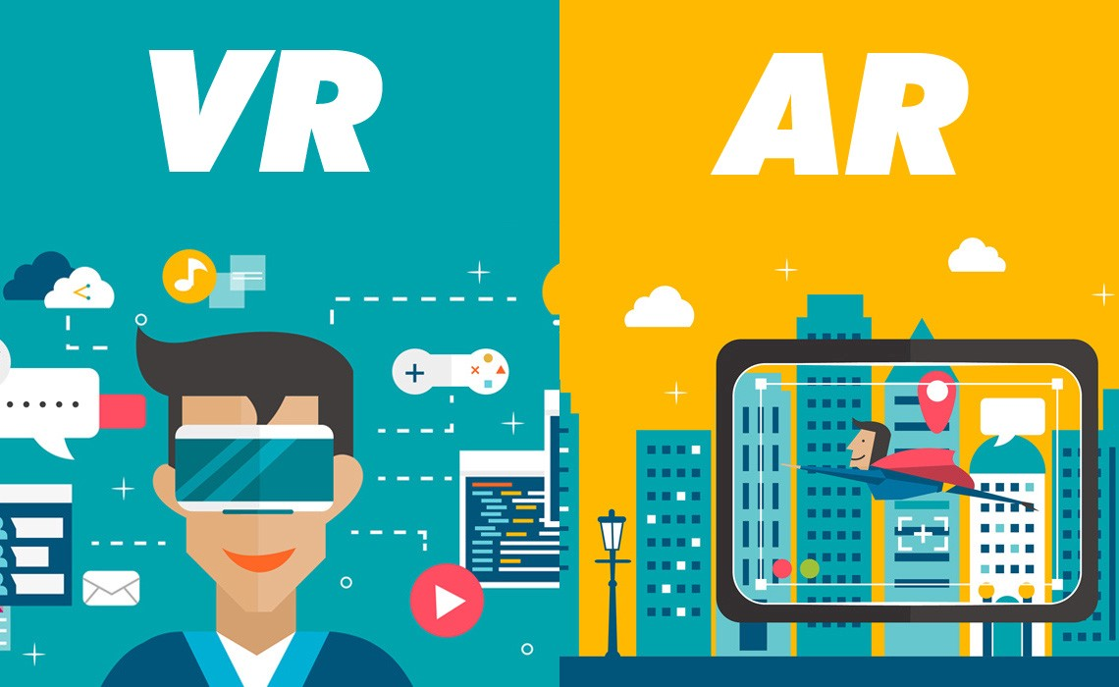
VR vs. AR
What is VR? Computer generated 3D image or environment.
Ex. Video games through Oculus.
What is AR? Overlapping our world within a lens/camera to show digital content such as videos, animations, sounds, and graphics.
Ex. Snapchat, Football, etc.
Notes:
VR the computer-generated simulation of a three-dimensional image or environment that can be interacted with in a seemingly real or physical way by a person using special electronic equipment, such as a helmet with a screen inside or gloves fitted with sensors.
AR or Augmented Reality is an enhance real world surroundings overlaying by computers that create digital content such as video, animations, sounds, and graphics. Launched by tech recognizing an object through a camera thus launching an object or visual.

Slide 5
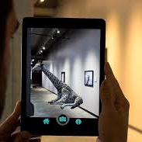
So what exactly is AR?
What is AR(Augmented Reality).
For developers, there are plenty of platforms that they can use in order to perform an AR project. Such as Echo AR and Adobe Aero.
Notes:
AR or Augmented Reality is an enhance real world surroundings overlaying by computers that create digital content such as video, animations, sounds, and graphics. Launched by tech recognizing an object through a camera thus launching an object or visual.

Slide 6
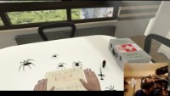
Example of VR

Slide 7

Example of AR

Slide 8
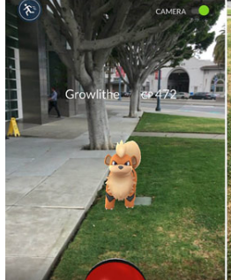
DO YOU USE AR TODAY?

Slide 9
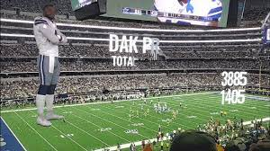
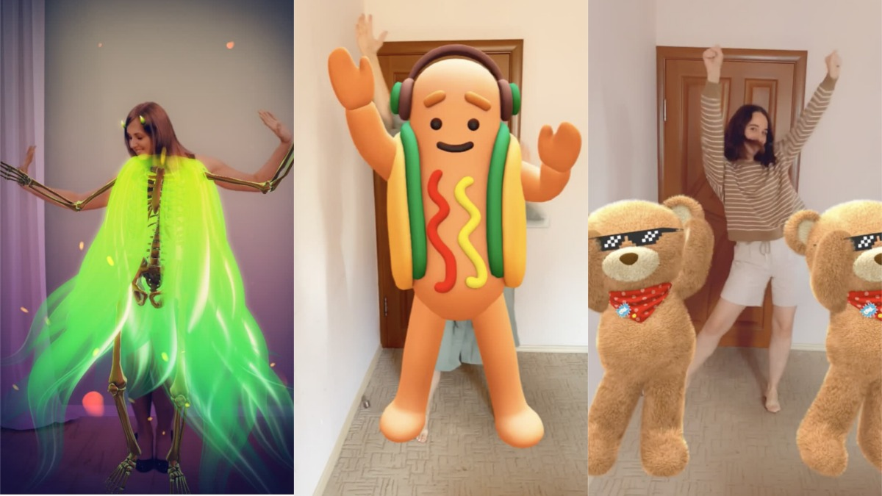
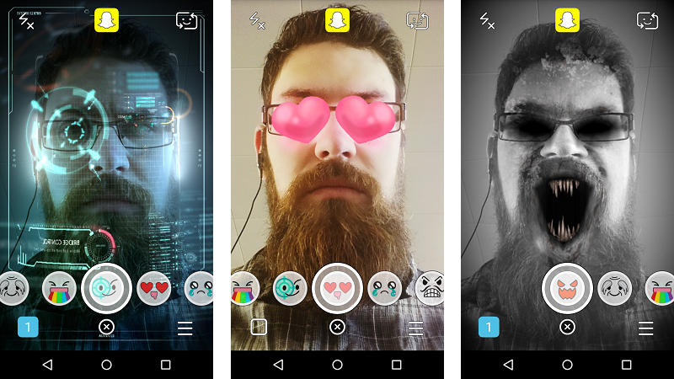
AR in today
Here is how Football is using AR to present their players.
The camera recognizes the human body which then launches a model to follow the body as it moves.
Here the front camera recognizes the eyes, mouth, and outer head to then create an anchor where it can place the objects or visuals.

Slide 10
Vocabulary
Model: A person’s online representation as a character, whether in the form of a 2-D or 3-D image.
Image Tracking: The image recognized by the App, which launches the AR experience.
Tracking: Allows you to launch the AR experience with an Image Target in the camera's view persist the experience even when you're not tracking the image.
QR-Scan-Code: it is a type barcode which can be scanned using a QR scanner which leads to links.
Notes:
barcode(Usually built in Cameras have them already)

Slide 11
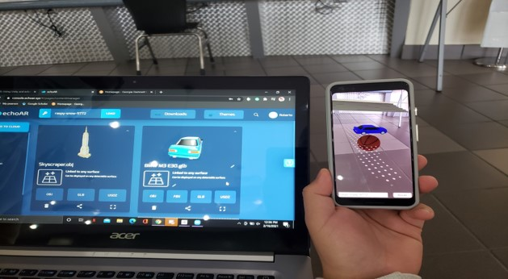
Echo AR
What Tech?
iPad and Tablets
We decided as a group to stick with echoAR it works well with both Apple and android products.
What is EchoAR?
Echo AR is a platform where you can generate digital objects through your phone.
Notes:
We are developing an Augmented Reality tutorial to introduce the audience to AR. Our goal is to show the importance of AR and how it is used in today's world. AR enhances real world surroundings by layering digital content such as video, animations, sounds, and graphics on top of the real world. The most commonly used devices for AR applications today are smartphones and tablets.
We used the echoAR technology to design our project tutorial. We created several 3D models for our tutorial, such as our 3D grizzly model. We used these models to show our participants how a marker is used to trigger a virtual 3D model to appear overlayed on top of the real world. We then showed them how to create a simple AR application.

Slide 12
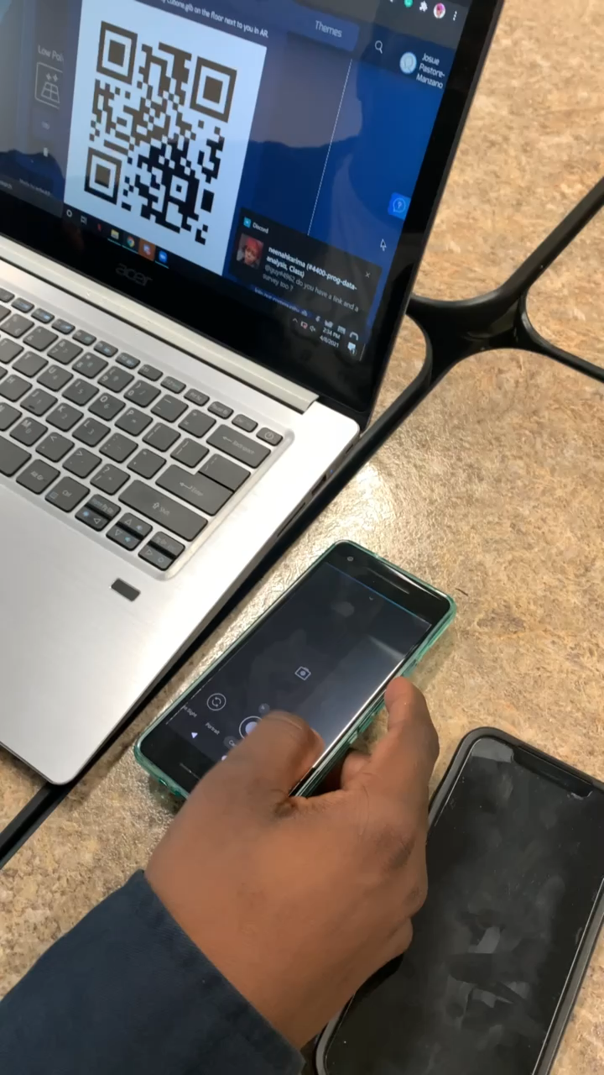

Slide 13

Please follow this link on your phones:
https://go.echoar.xyz/WgKn or if you want to see it on the app( echoAR Go) we can use this Key Code lingering-poetry-6509 or Scan the image to the right.
From there you should be able to interact with the image.

Slide 14
Tutorials
Here are the links to our examples:

Slide 15
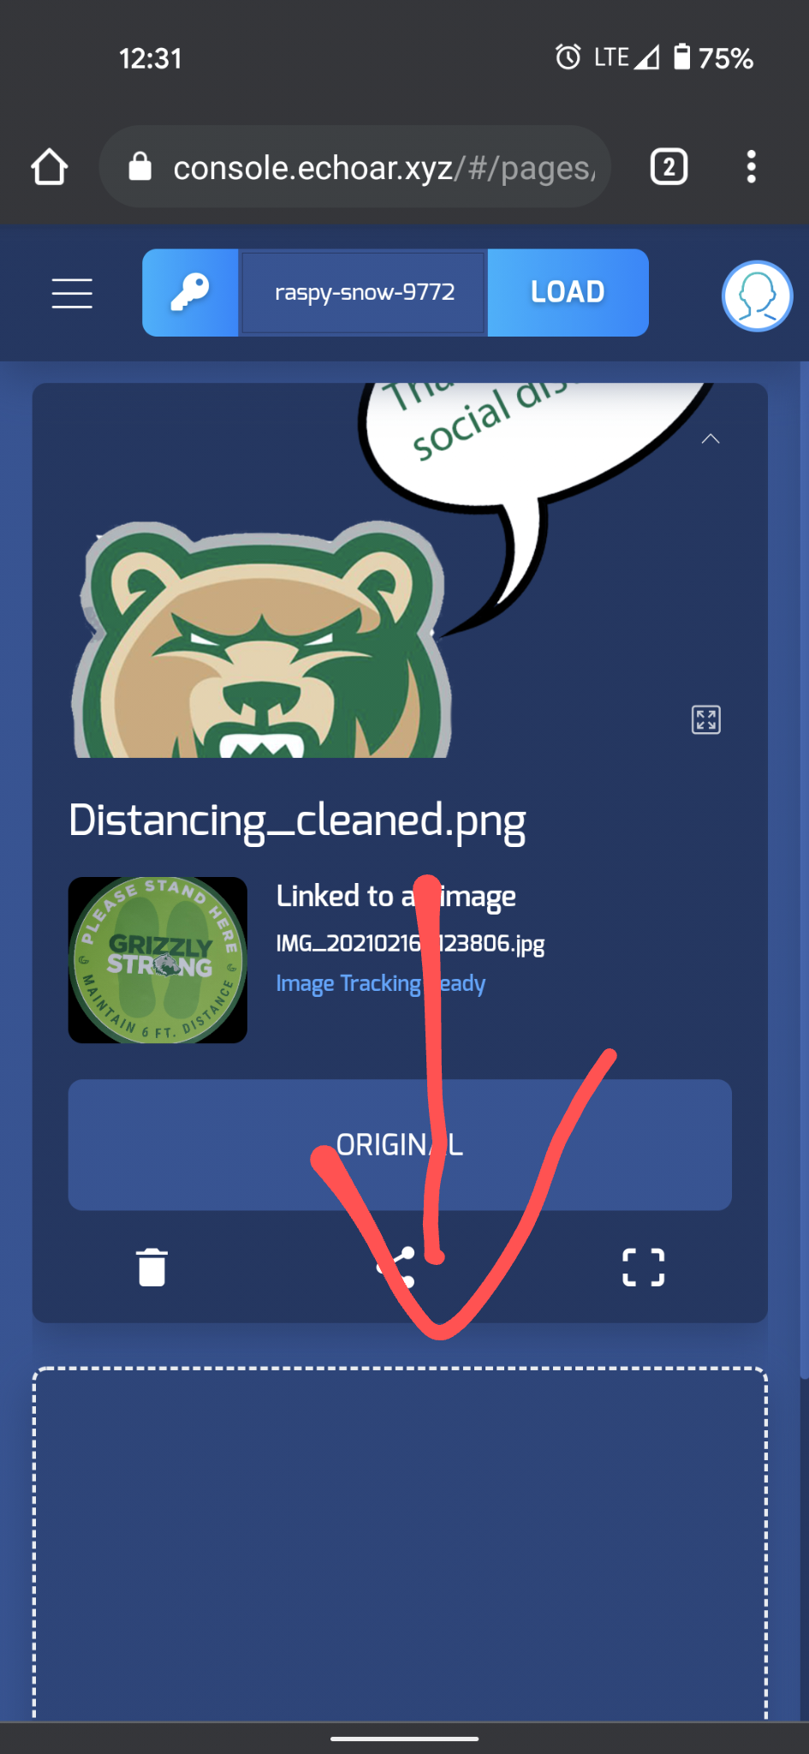
Creating a project

Slide 16
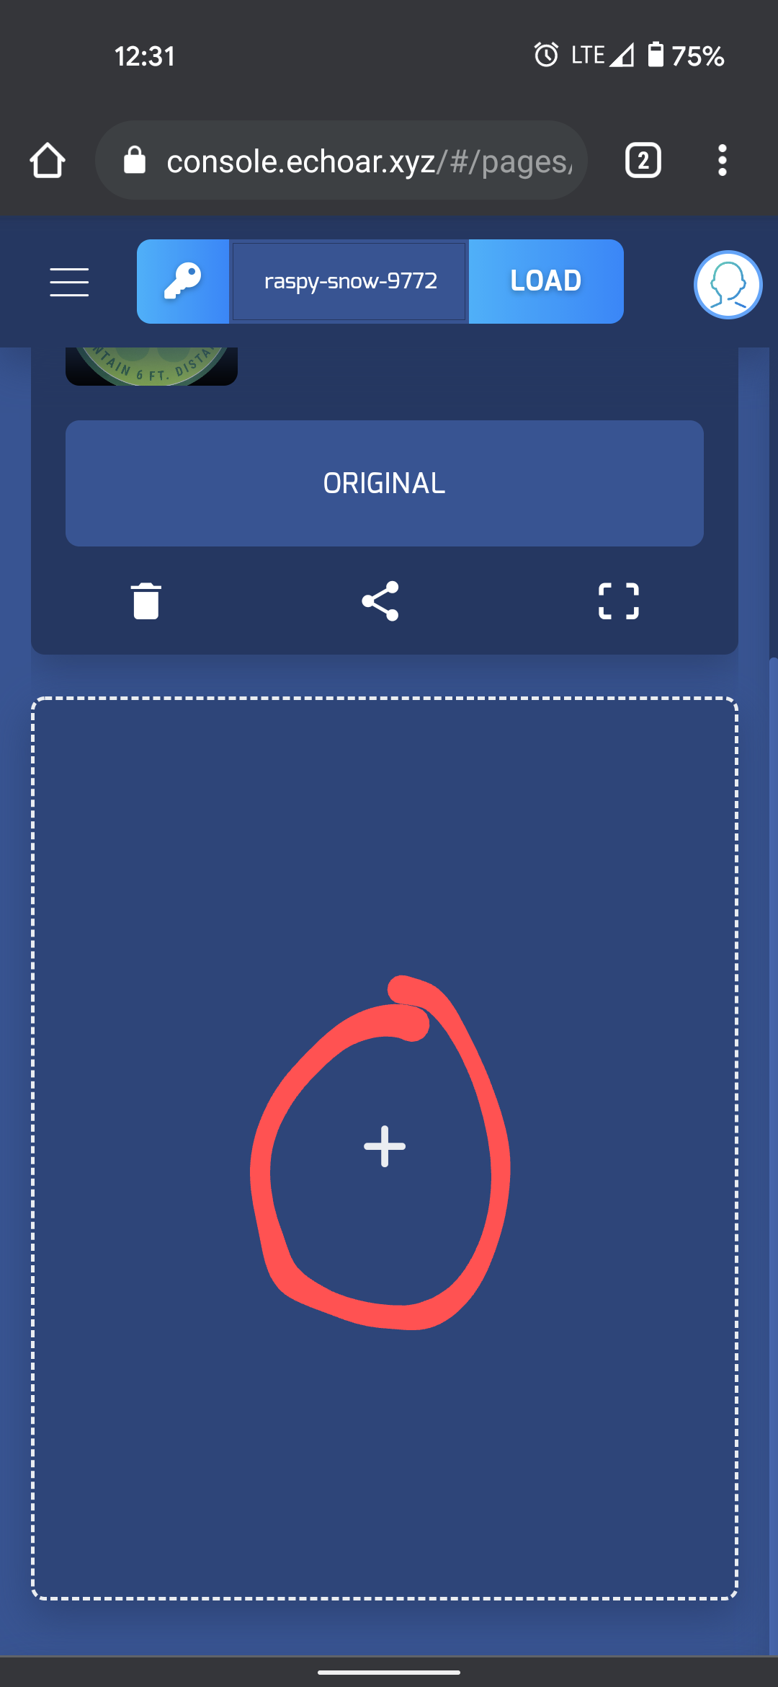
Creating a model

Slide 17
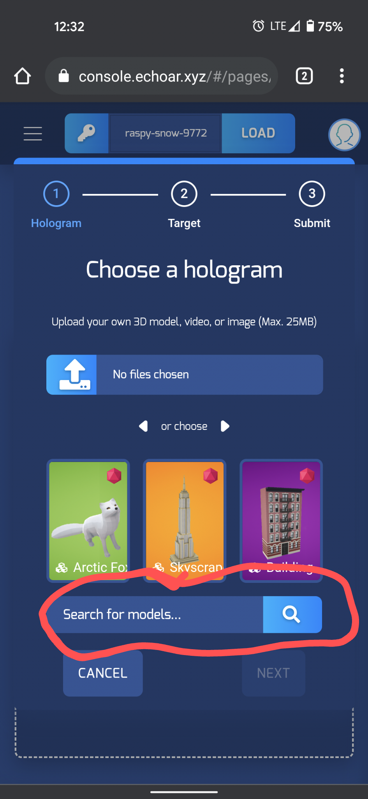
Uploading a model

Slide 18
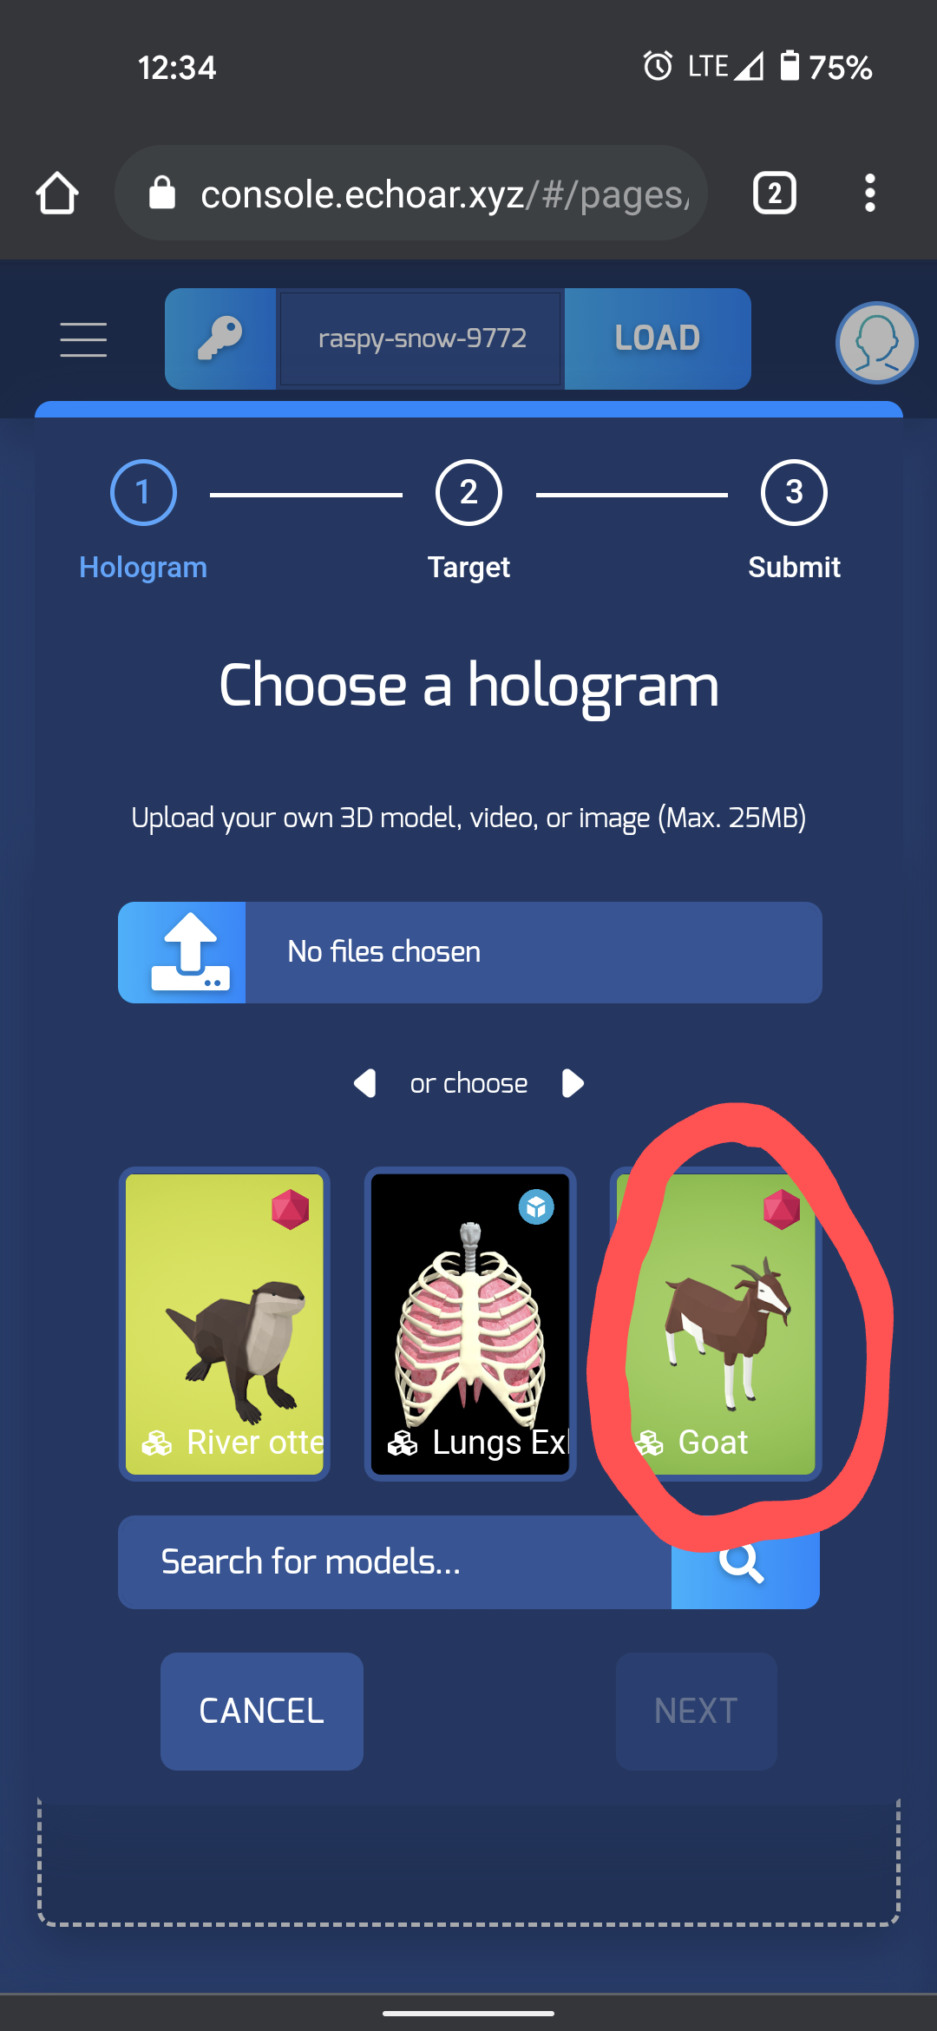
Selection

Slide 19
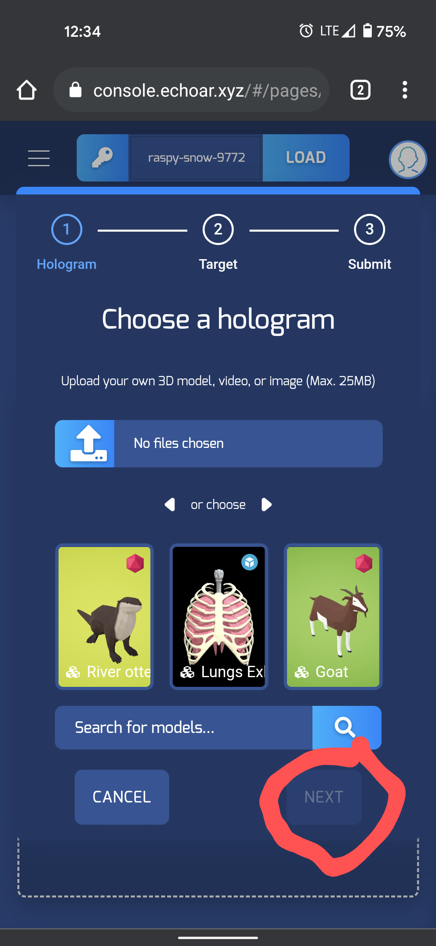
Confirming the Selection

Slide 20
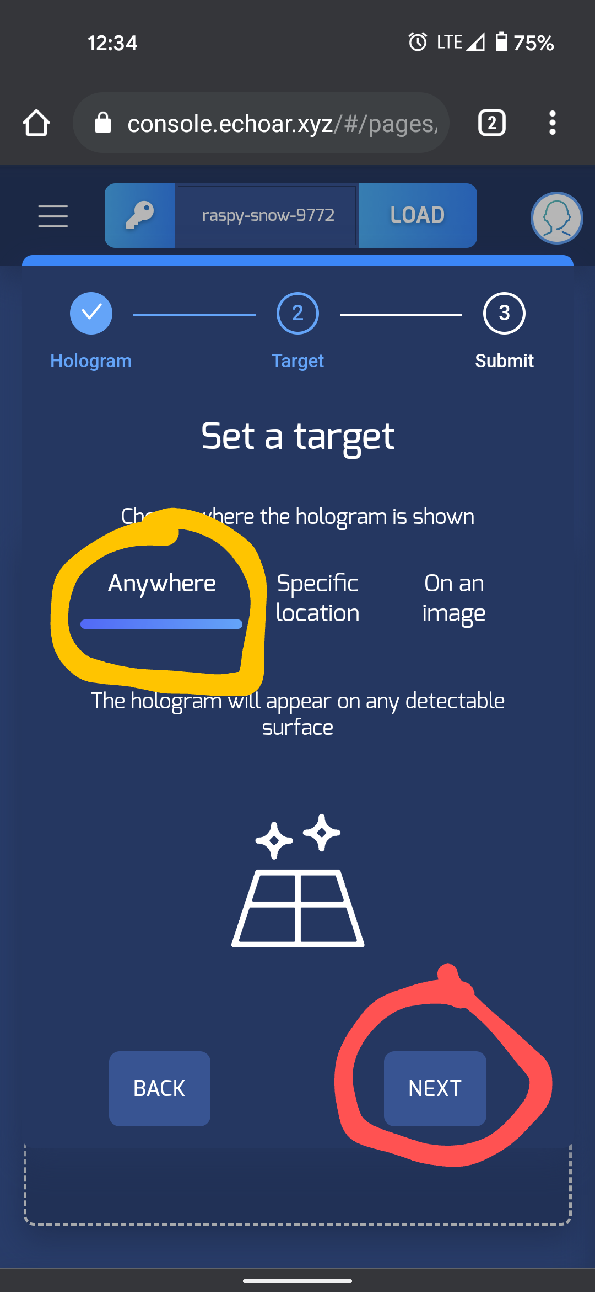
Selecting a Display Target

Slide 21
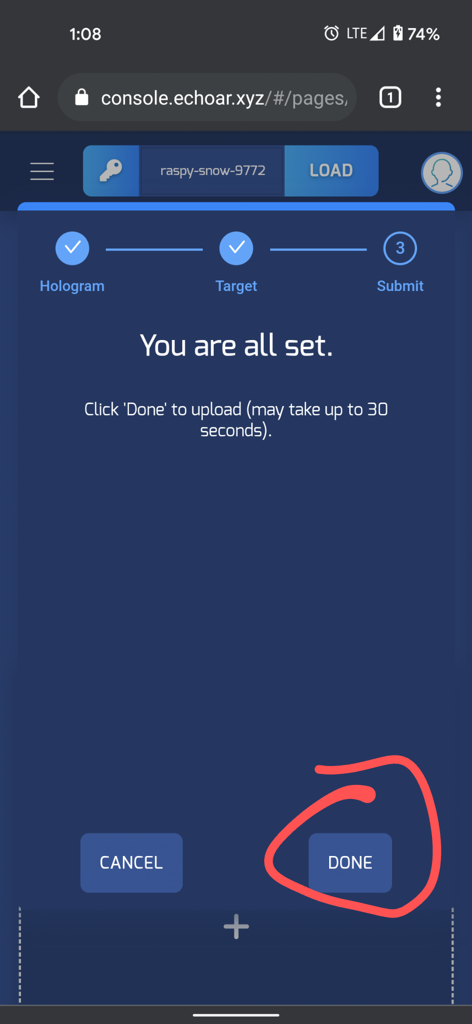
Model uploaded successfully

Slide 22


White-Screen

Slide 23
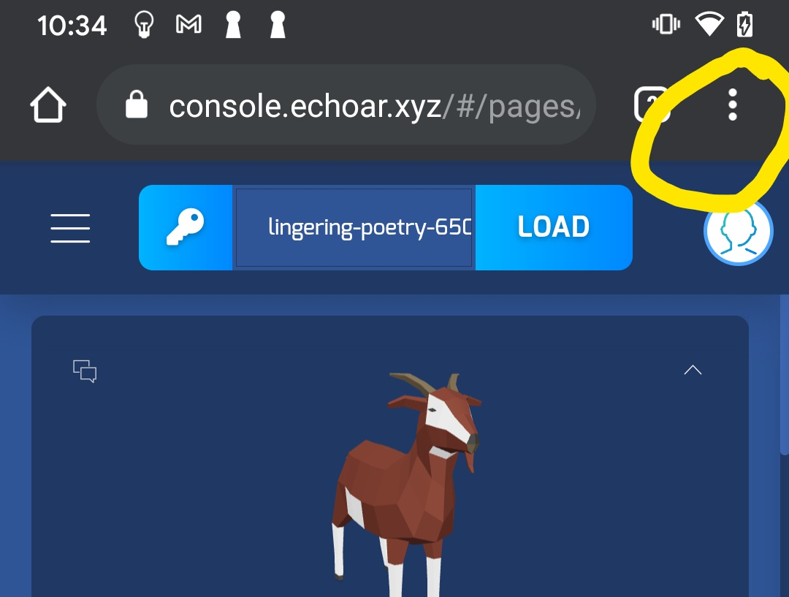
Select the menu Bar

Slide 24
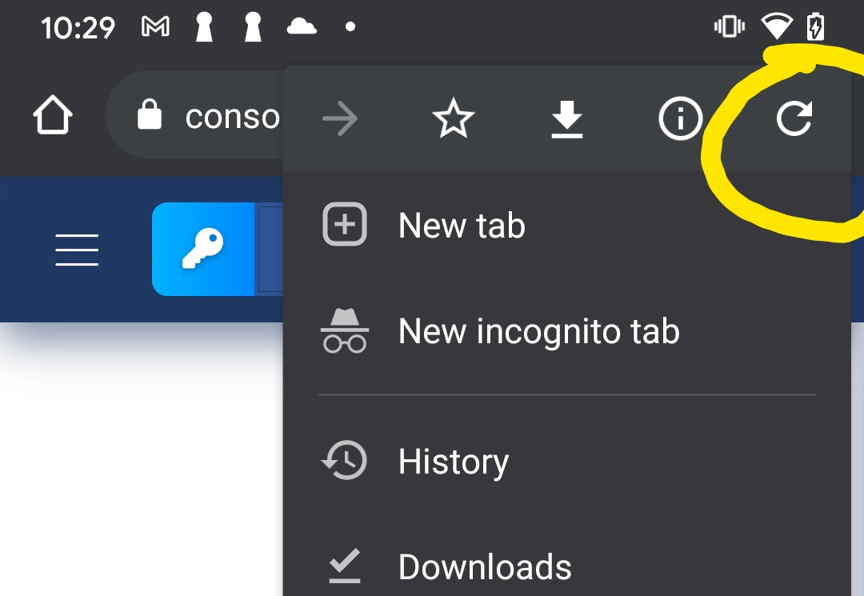
Refresh the Page

Slide 25
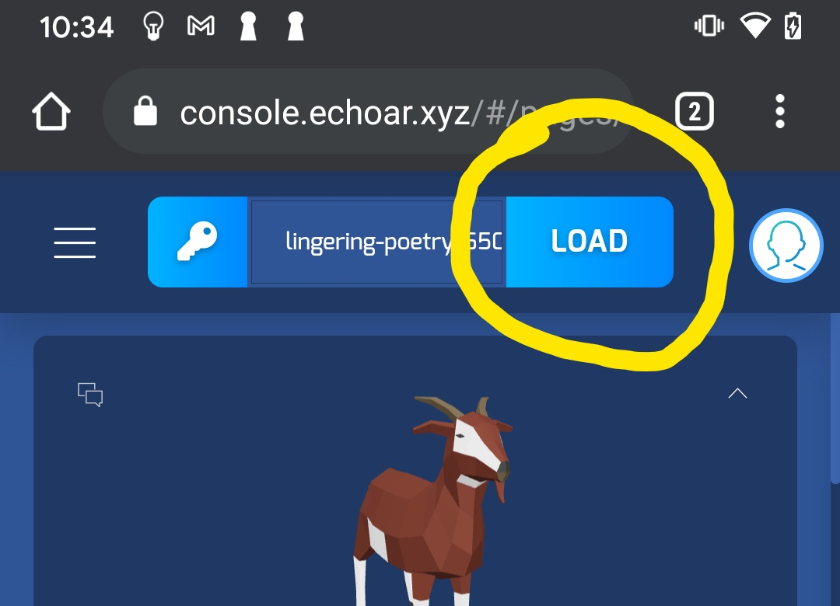
Load the Page

Slide 26
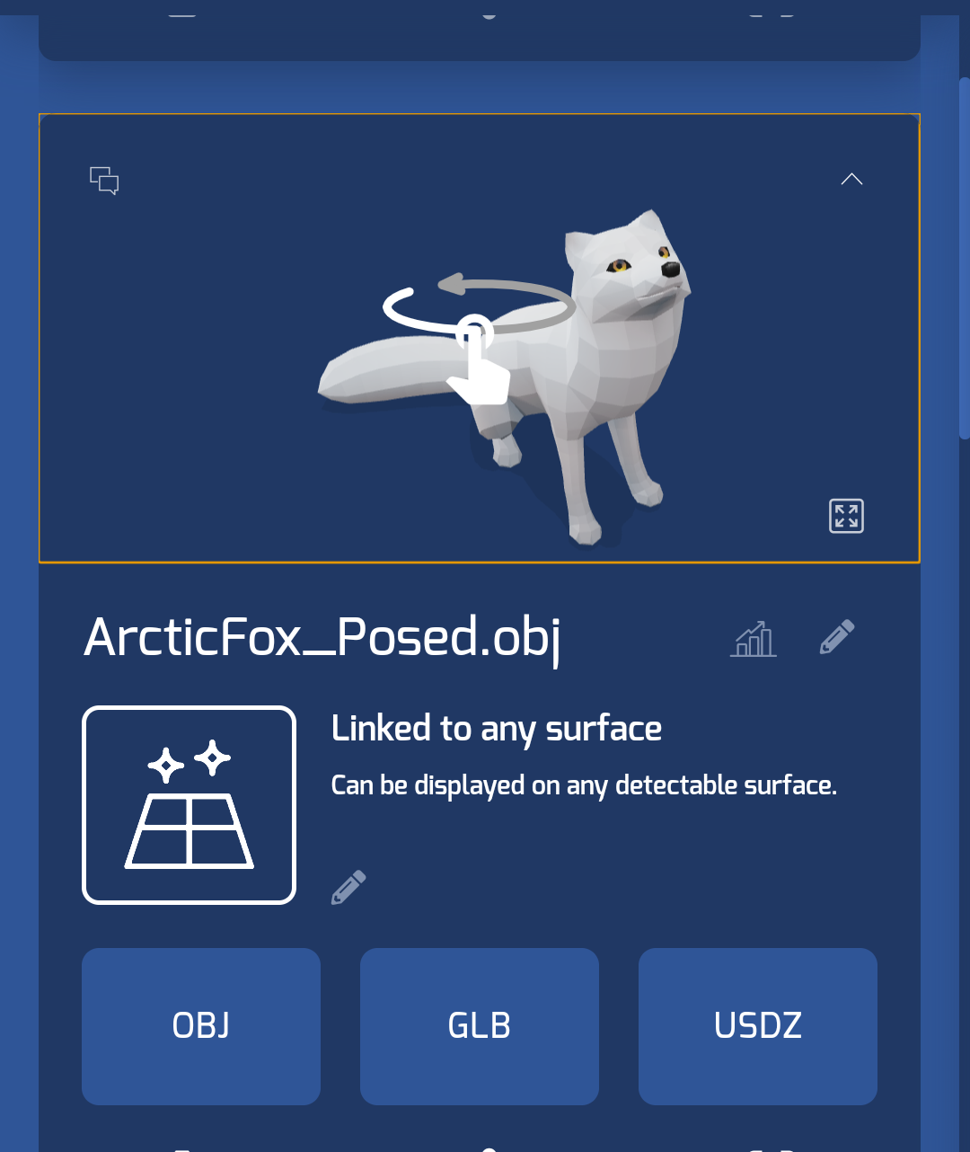
Scroll Till You See your Selected Object

Slide 27
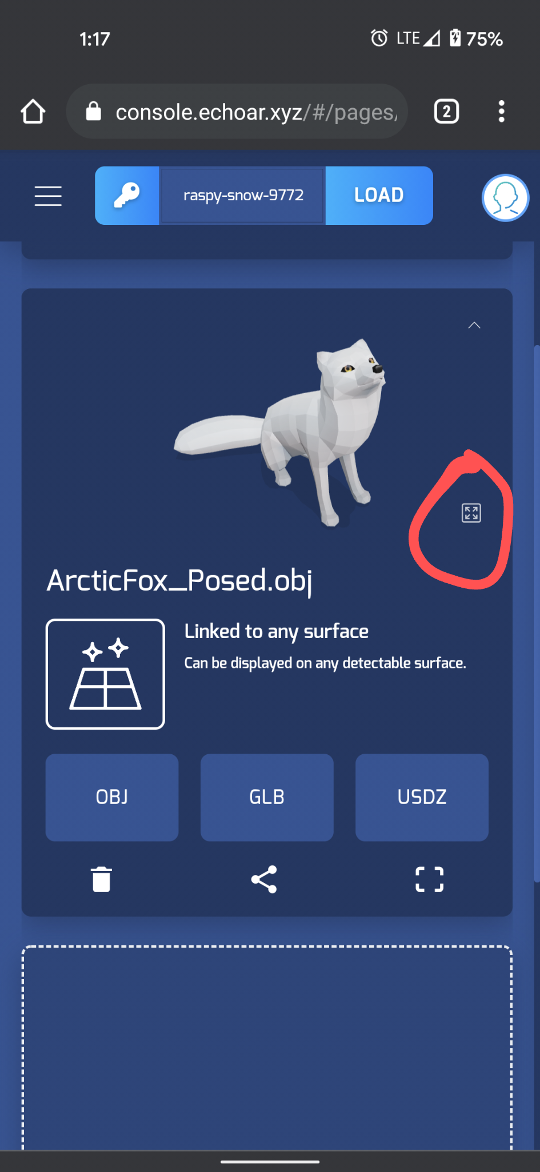
Click Full Screen

Slide 28
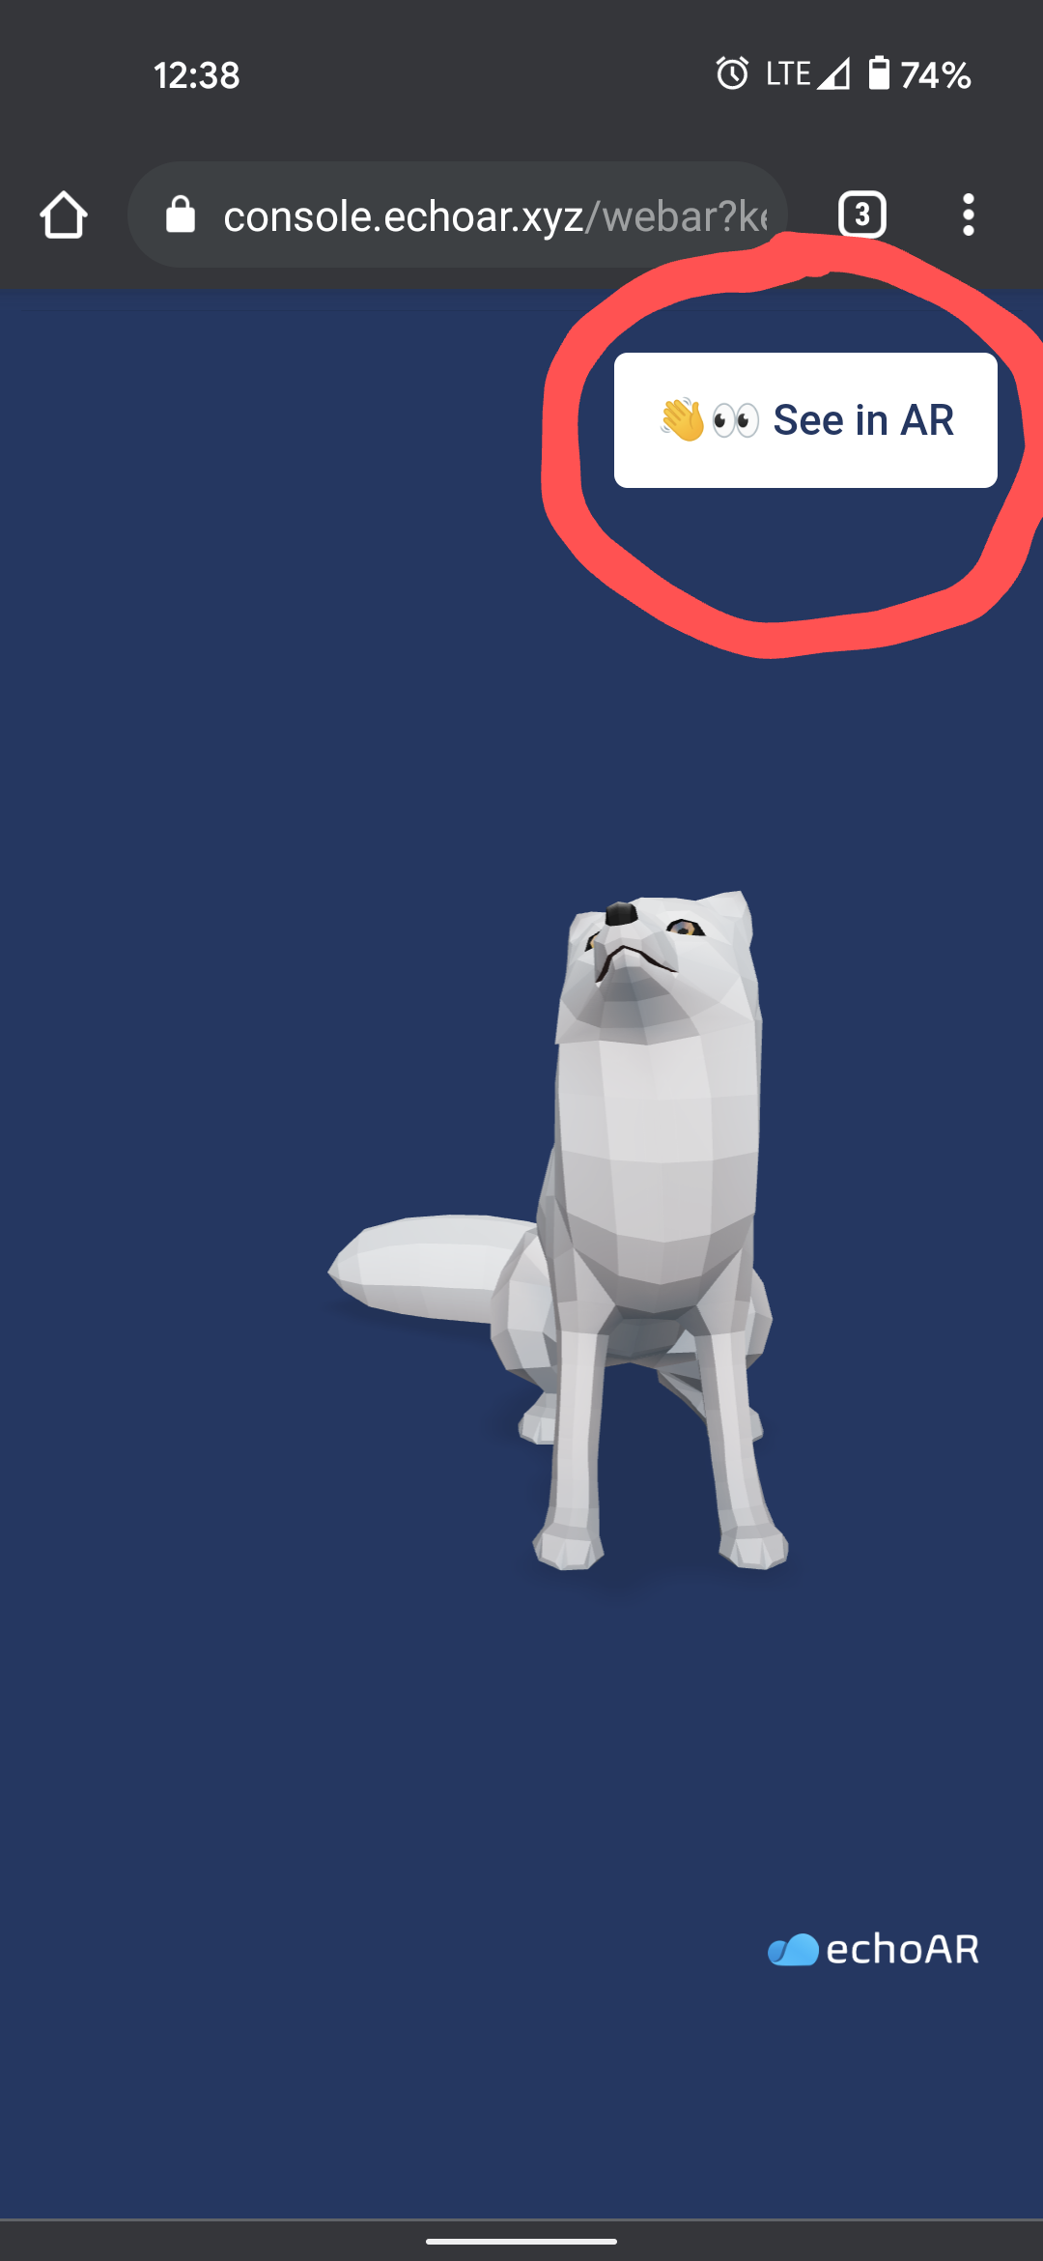
See In AR

Slide 29
Last thing
EchoAR is heavily supported by Unity and we attempted to re-create one of their own tutorials and here is what we got from it…

Slide 30
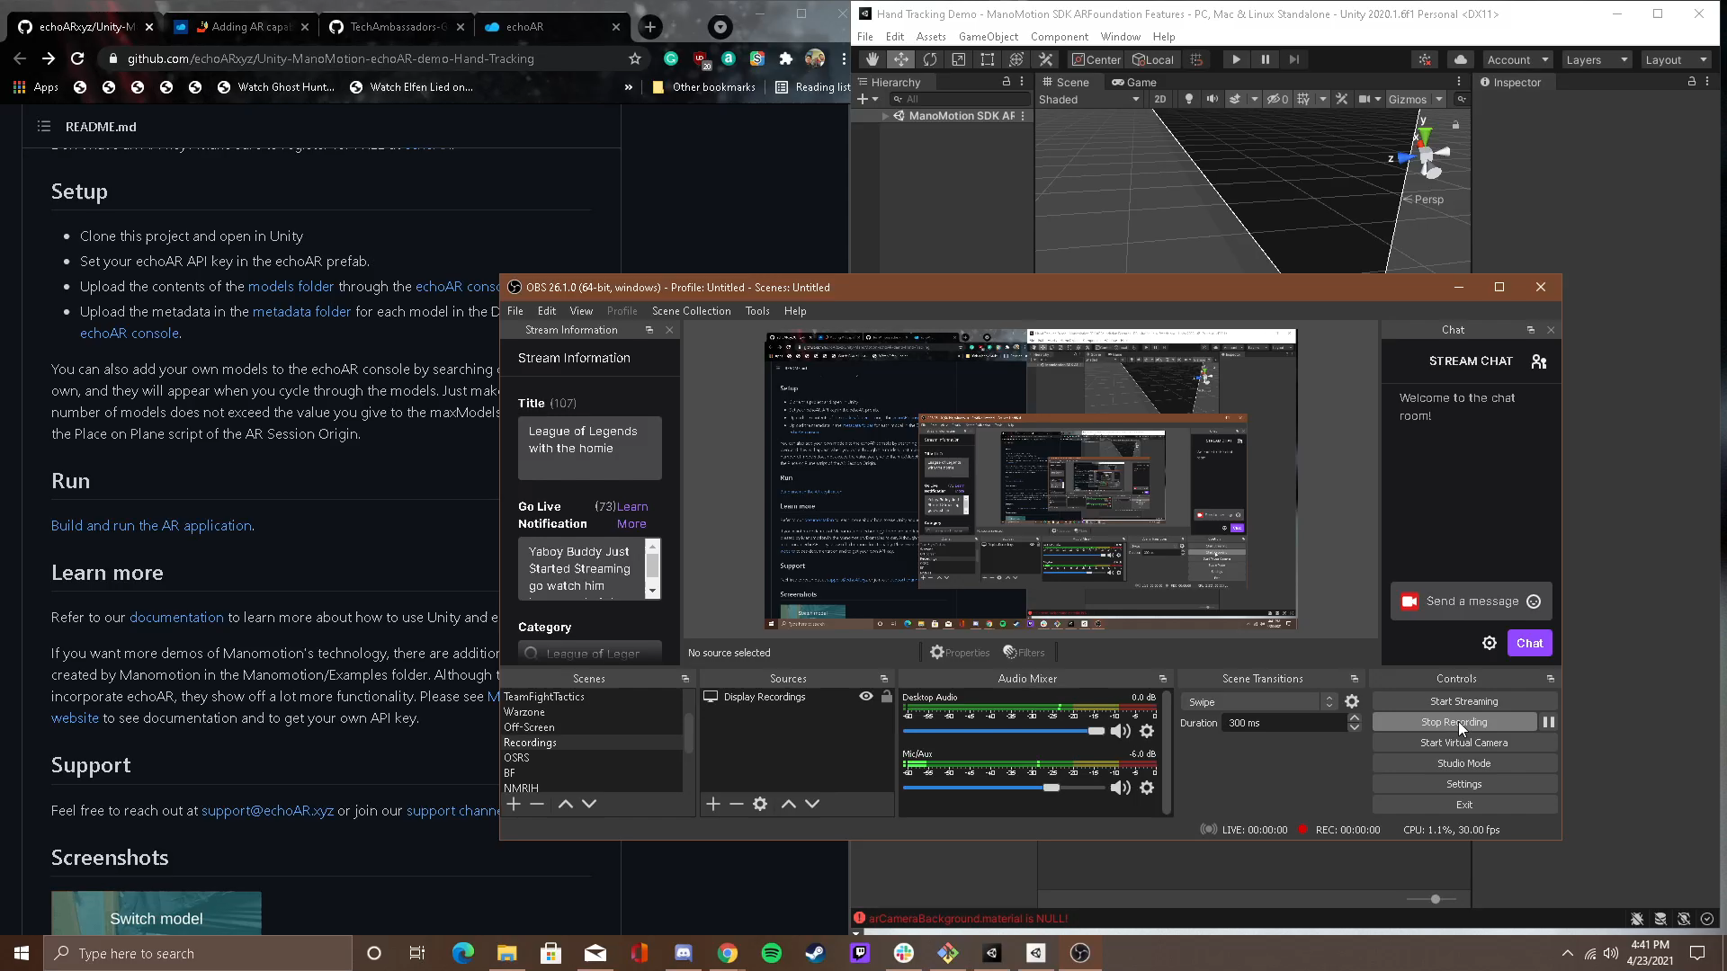

Slide 31
Unity
What Tech?
What We Hope and Our Vision
Android and iPad
Unity provides users with manual editing, the shape color, and the movement.
Unity is a cross-platform that can be used to create mobile games in 2D or 3D.
Unity is also a platform where you can type in your game scene in order to get your item to interact in a specific demand. You can use Unity to type in codes for another platform like Echo AR.

Slide 32


Thank you, guys. Post-Survey: https://ggc.az1.qualtrics.com/jfe/form/SV_9tcgXJdZzJptLVQ

